Slide 2


Slide 3

Group 9
Jake Hochstadt EE
Matt Simons EE
Jerome Yearwood EE
Ryan Moreland CpE

Slide 4
Goals
Emergency Vehicle Alerts via an already existing system
Safety in School Zones and Construction Zones
Navigation Directions
Driver and Pedestrian safety
Notes:
1 minute slide
Talking Points:
-Mention how emergency vehicles can change intersection lights. We are using this system… Be sure to say that we will explain the system in detail in the IR section
-Place the IR beacon in construction and school zones to notify drivers
-Will be displayed mirror and the mobile device
-It’s better to look at the rearview mirror than looking down at your phone on your knee every 6 seconds.

Slide 5
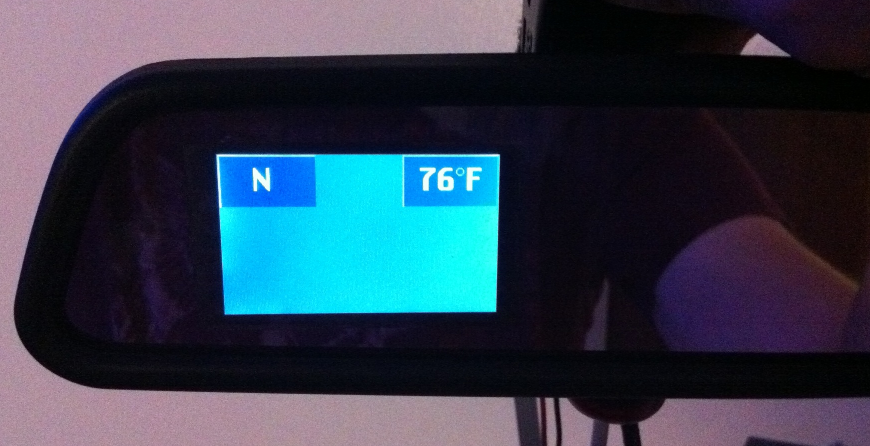
Notes:
(15 second slide)
Here’s another picture to show a better simulation of what the final product will look like on a rearview mirror

Slide 6
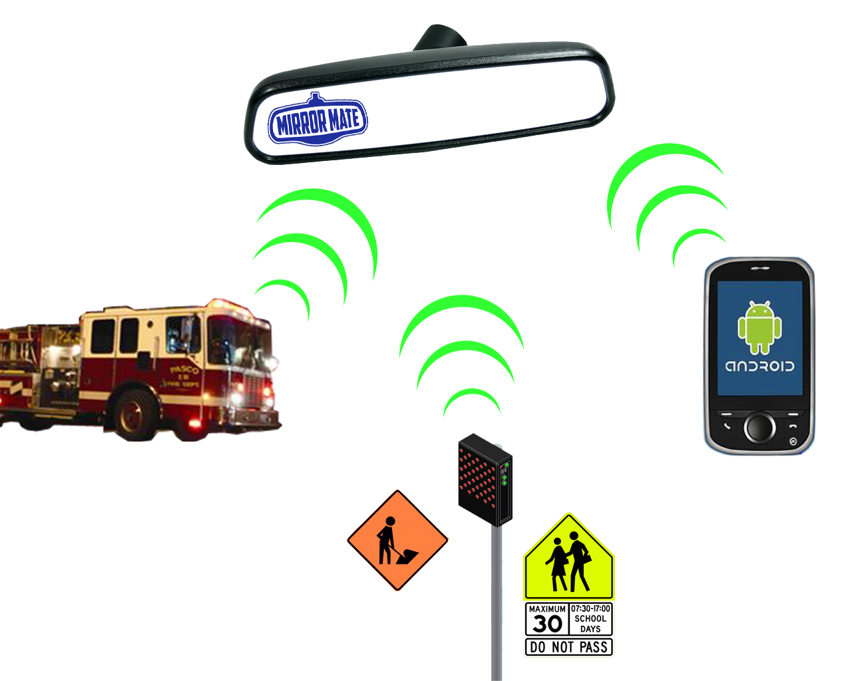
MirrorMate in a Nutshell
Notes:
(1 minute)
High level must mention each subsystem of the project and how it works together. Give a brief explanation of each subsystem

Slide 7
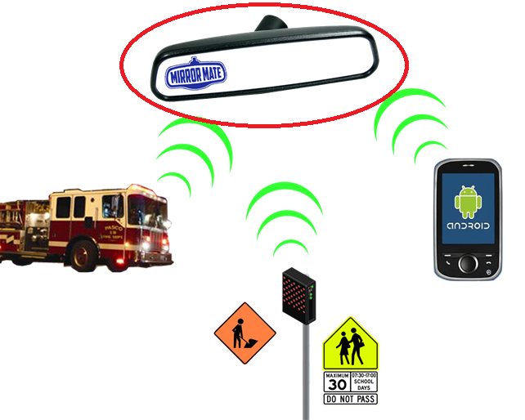
Display and Microcontroller
Jerome Yearwood
Notes:
Segue slide
Introduce Jerome to talk about the Display stuff
(15 second slide)

Slide 8
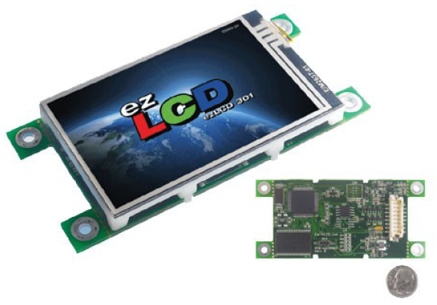
LCD Display
ez-LCD-301
2.6” TFT LCD color display
400x240 resolution
4Mbytes flash memory
3.3V operating voltage
Programs in ASCII
Serial TTL interface

Slide 9
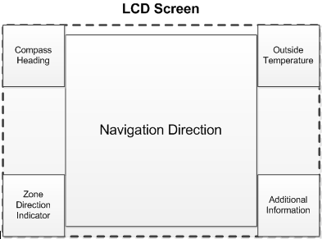

Slide 10
MirrorMate Display Color | Description
RED | Emergency Vehicle is approaching
YELLOW | The vehicle is approaching a school zone that has an altered speed limit.
ORANGE | The vehicle is approaching a construction zone that has an altered speed limit.
BLUE | The vehicle is approaching a special event zone that has an altered speed limit.
PURPLE | The vehicle is approaching an accident scene that has an altered speed limit.

Slide 11
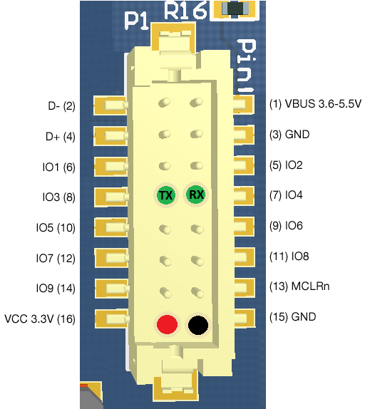
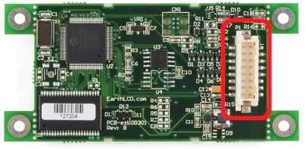
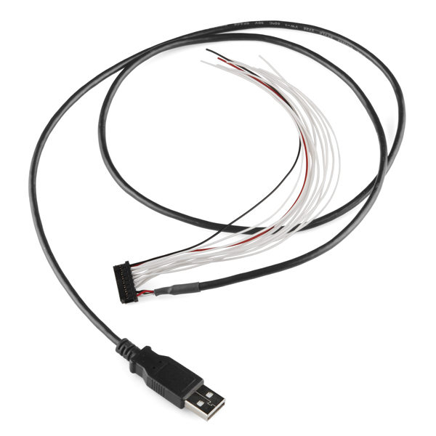
LCD TTL Serial Interface

Slide 12

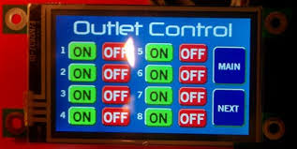
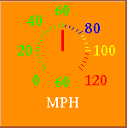





Widgets
BUTTON {id} {X} {Y} {Width} {Height} {Options} {Align} {Radius} {Theme} {StringID}
STRING 0 ON
BUTTON 1 10 10 100 100 1 0 10 2 0

Slide 13
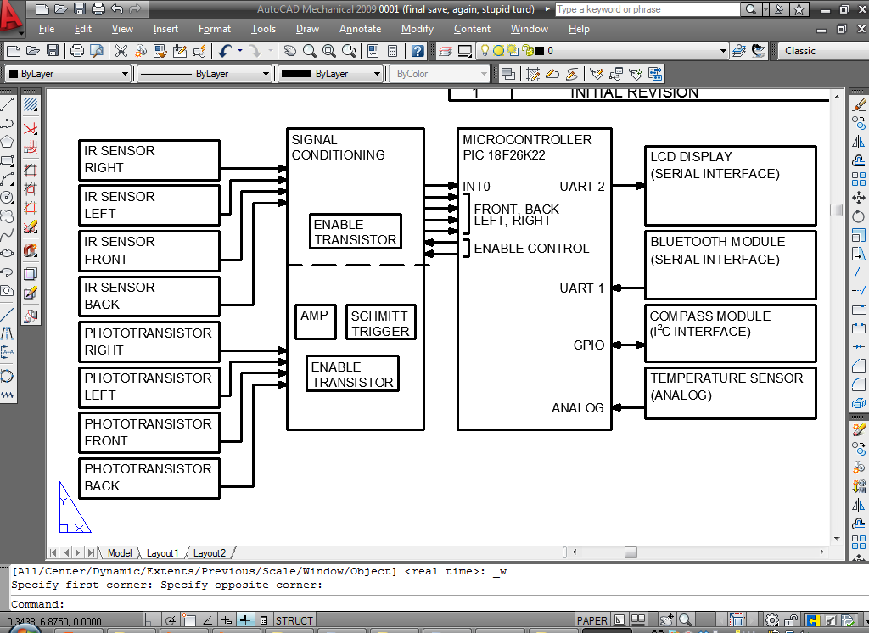

Slide 14
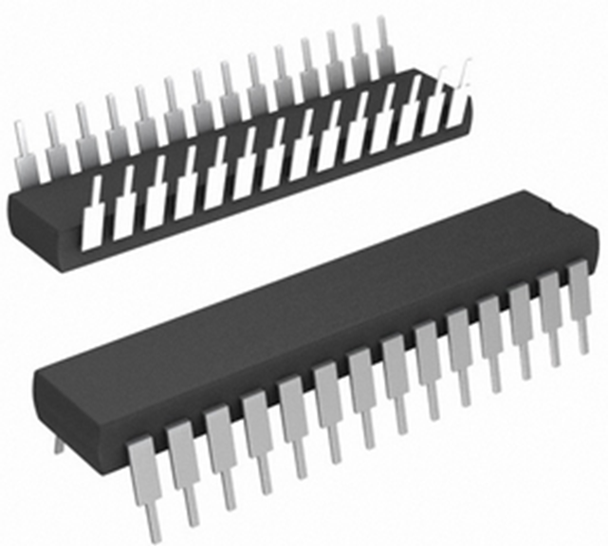
Microcontroller (PIC18F26K22)
Operating voltage
  V_{DD} =1.8 to 5.5V
  Operating at 3.3V
Program memory flash 64KB
16 MHz precision internal oscillator
  Operating at 64mHz using PLL
2 EUSART ports
  Utilizing TTL RS232
GPIO (I²C interfacing)
Analog to digital converters
16 bit timer0
Notes:
Don’t talk about features we aren’t using
Say ‘Phase locked loop’
Talk about ADC, 10 bit res, maybe say used for temperature thing
Timer0 used for IR decoding

Slide 15
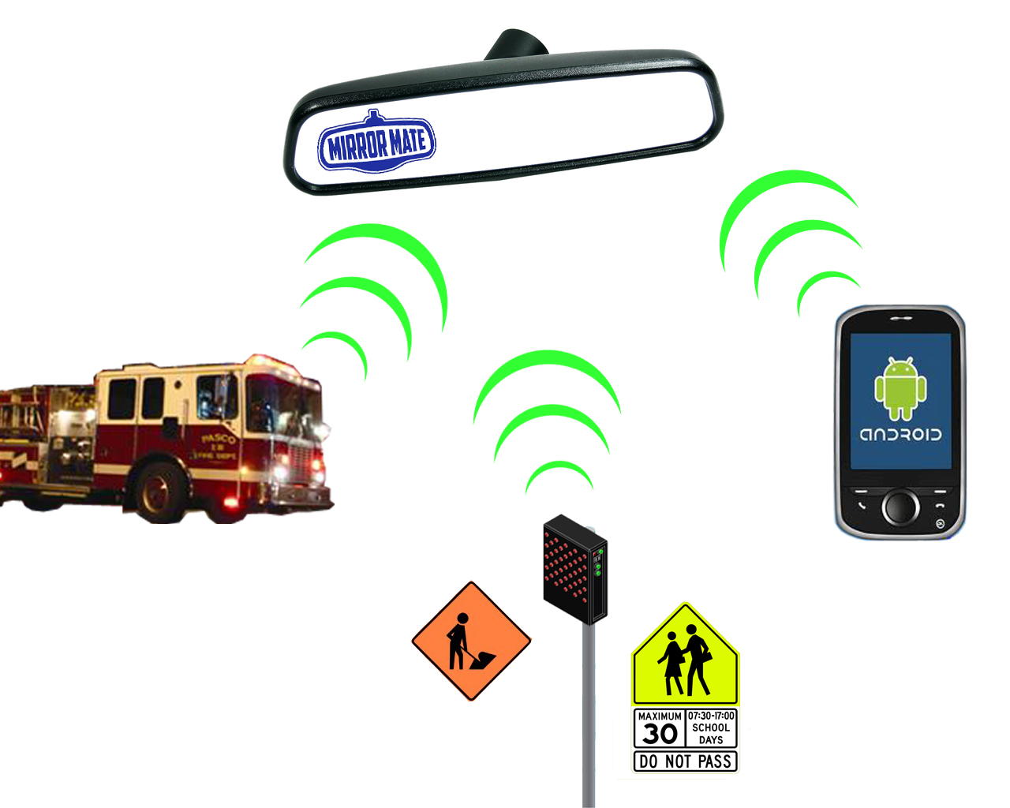
Infrared Systems
Matt Simons

Slide 16
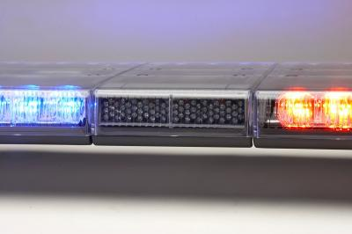
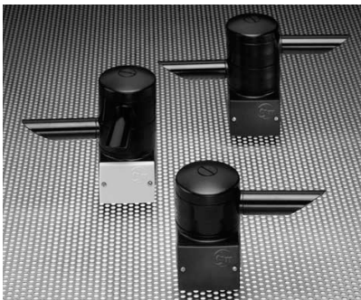
What is Opticom?
2 ft.
Opticom is a traffic light preemption system currently used by emergency vehicles to quickly maneuver intersections
Utilizes a powerful IR beacon mounted on the emergency vehicle
IR sensors are mounted on the traffic lights
14Hz frequency, newer systems feature authentication
4 in.
Notes:
“First I will describe a few IR systems and then explain how they will be used by mirrormate”
- Here you can see the IR emitter inside the light bar that would be installed on the roof of a typical squad car (use laser beams)
- Some of you may have seen these sensors mounted on stop lights (laser beams)
- Datasheet says has a max range of about half mile.
- Authentication is achieved by encoding a vehicle identification number into the 14Hz IR carrier

Slide 17
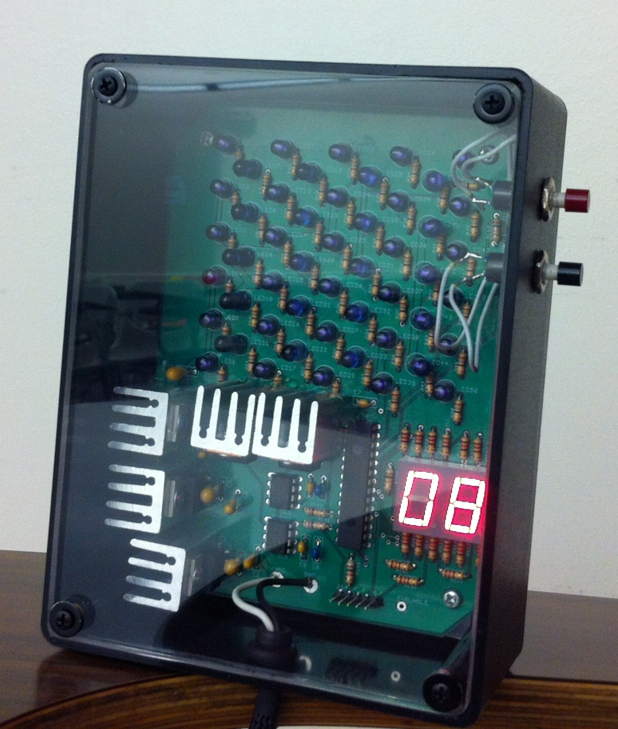
Reduced speed zone beacon
Placed in construction zones, school zones, accident scenes or anywhere a driving hazard exists
User configurable via buttons and seven segment displays
Features alerts for school zones, construction zones, accident scenes, and special events.
Notes:
This doesn’t exist, we are making it, it came from our brains!
Flexible mounting options, post, bob’s barricades, against a building
Easily configurable via the buttons on the side, confirms configuration changes on 7 seg

Slide 18
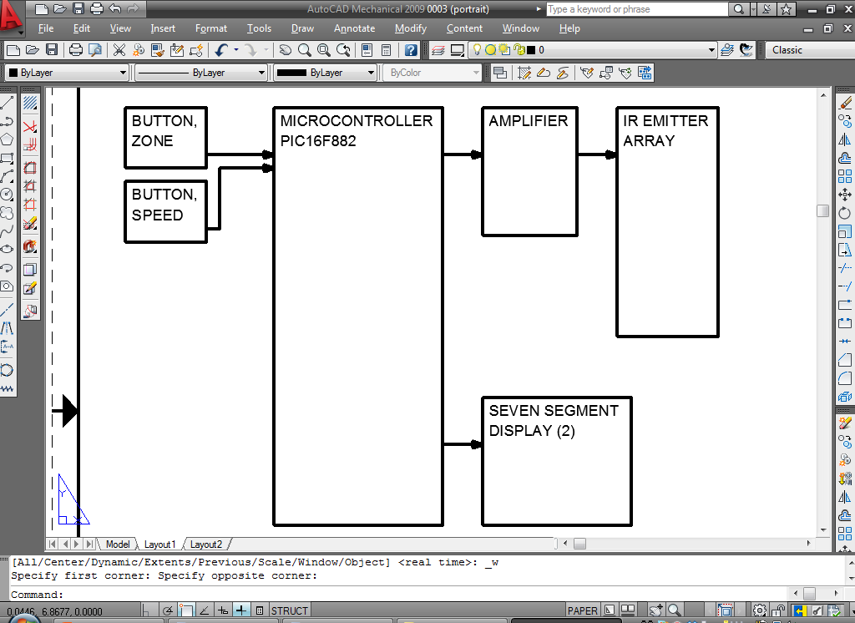
Beacon details
Utilizes peak wavelength of 950nm at 38kHz, High power emitters
Encodes information into RC-5 similar protocol
50 high power emitters
6VDC power
Notes:
Say just under thousand, talk about different LED types used, TEST UNDER IDEAL CONDITIONS
The protocol will be a mix between the RC-5 and NEC type remote control protocols. This ensures security through obscurity and also ensures the beacons will not interfere with any existing devices.
The beacon will use 41 high power LED emitters and a MOSFET amplifier circuit
The beacon will operate on battery power, can be powered by construction vehicles, or by mains voltages.

Slide 19
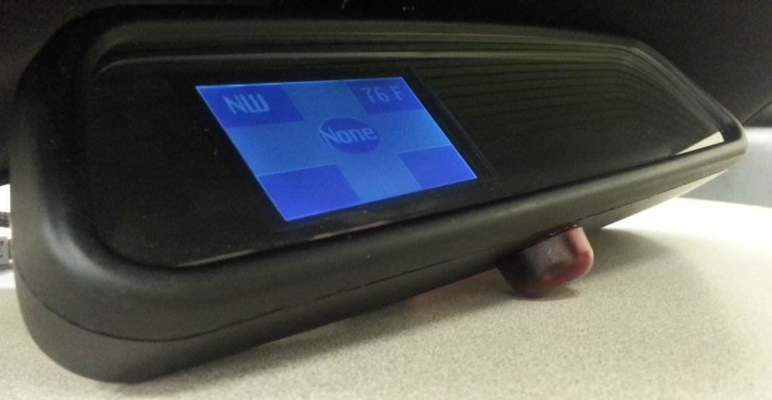
MirrorMate IR receiver
Two different frequency receivers to accommodate the Opticom system (14Hz) and the reduced speed zone beacon (38kHz)
The 14Hz signal will be detected via phototransistors, schmitt triggers, and firmware
The 38kHz carrier wave is removed from the IR signal via integrated IR receivers. The data is interpreted by the MCU
Four directional receivers located in the bottom of the mirror determine direction
Notes:
The 14Hz opticom signal only needs to be detected. The authentication codes will not be decoded.
The receiver will be located in the bottom of the mirror in a small IR transparent enclosure as shown

Slide 20
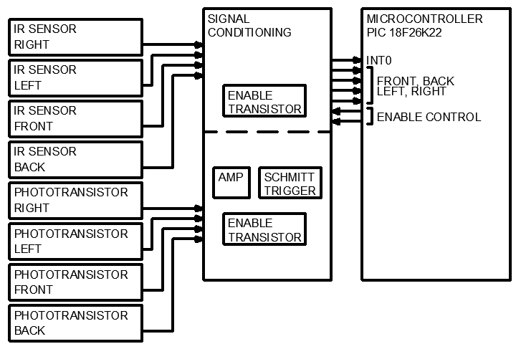
Notes:
Talk about the enable transistor toggling, about every second.
Here is a block diagram of the IR receiver portion of mirrormate
See the two receivers blah blah
If we need more time talk about optics, lack there of

Slide 21
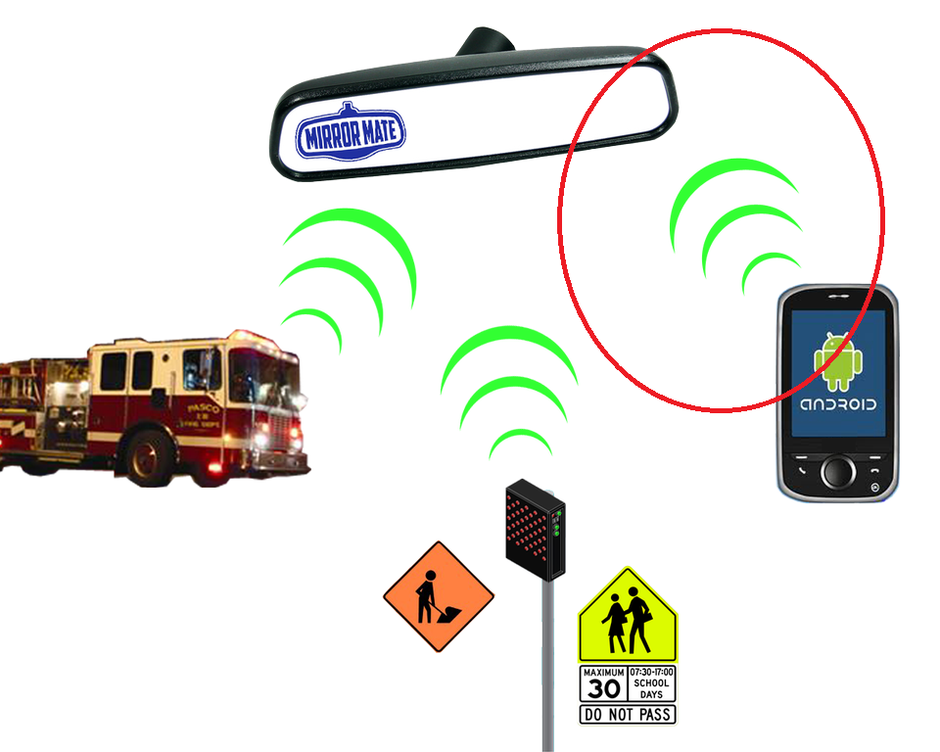
MirrorMate Subsystems
Jake Hochstadt

Slide 22
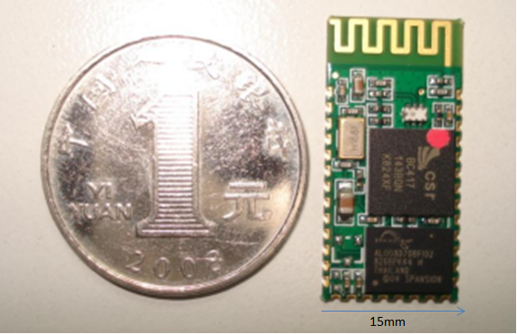
Bluetooth Hardware
HC-05 Bluetooth Serial Module
Current Requirements:
  8mA – 40mA
Voltage Requirements:
  3 - 4.2 V
  Operates at 3.3V
Benefits
  Inexpensive
  Serial Interface
  Ease of use
Notes:
Ebay part, paid about 8 dollars shipped. We found a seller from New York
2.0 doesn’t have enhanced data rate but will work
Supposed to work out of the box in a rs232 configuration. The TX and RX pins on the chip will be wired directly into our PIC microcontroller
Chinese part made by a Chinese company. Some of the documentation is in fragmented and half translated English

Slide 23
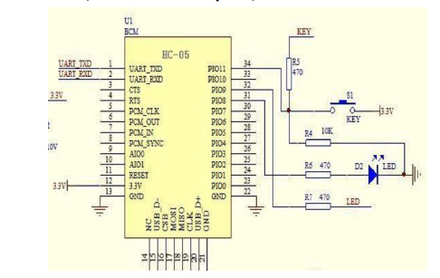
Notes:
The above diagram is how we’re going to connect the Bluetooth module to the PIC microcontroller
The configuration on the right is used to change settings on the adapter. For instance, resetting the adapter, or changing the modes

Slide 24
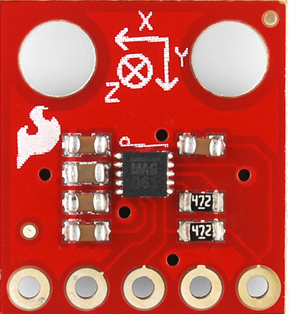
Compass
MAG 3110
Magnetometer Breakout Board
Triple Axis
Voltage Requirements:
  1.95V to 3.6V
  Operates at 3.3V
I2C interface
13.5mm
Notes:
How’s it’s interfaced and layed out in the rear view mirror. Assumed to be horzontal, so we were able to calculate direction with just the x and y coordinates.

Slide 25
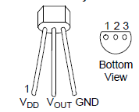
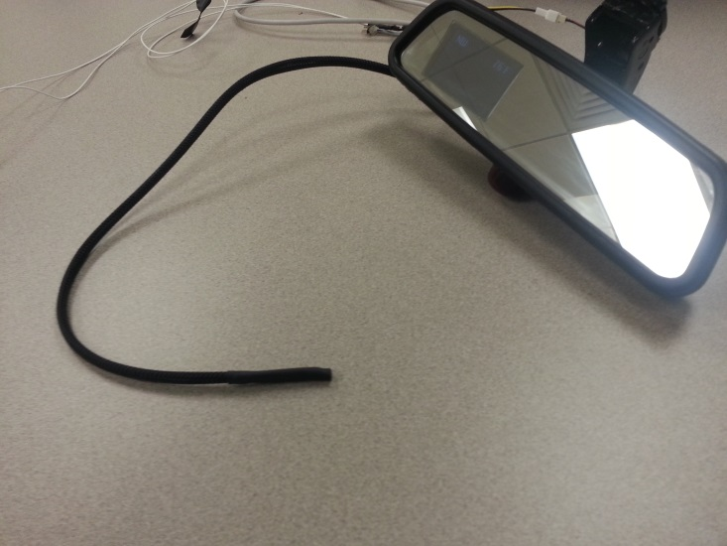
Temperature sensor MCP9701
Voltage Requirements:
  3.1V to 5.5V
  Operating at 3.3V
Current Requirements:
  6uA
Temperature Range
  -40°C to +125°C
Analog Interface
Ease of Use
Notes:
Insert picture of how it’s setup in the rear view mirror

Slide 26
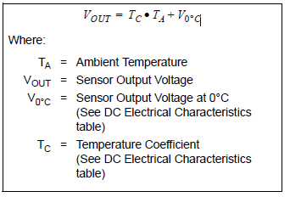
Sensor Transfer Function

Slide 27
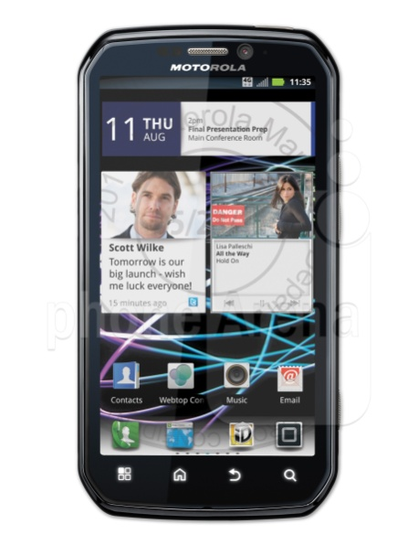
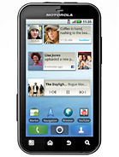
Android Development Phones
Motorola Photon 4g
Motorola Defy
Android (2.3)
Bluetooth: v2.1
Screen Size: 4.3 inches
Android (2.2)
Bluetooth: v2.1
Screen Size: 3.7 inches
Notes:
We chose these phones because these were the phones we had laying around. Both run Android 2.3. Android 2.3 is a slightly older version of Android but for the purpose of this app, it will work fine. Both run Bluetooth v2.1 which is backwards compatible with the bluetooth chips we picked, which are v2.0
The phones we chose to run our Android app are listed here. The Motorola photon 4g and the Motorola Defy. We chose these phones because to be honest, these were the phones we had laying around. They both run Android 2.3. They’re running somewhat older versions of Android but they will work perfectly to run our application. Both have the same version of bluetooth which is v2.1. Even though these phones have a newer version of bluetooth than the bluetooth module we chose, they’re backwards compatable which shouldn’t give us any issues. The screen sizes are a 4.3 inches for the photon and 3.7 for the Defy.

Slide 28
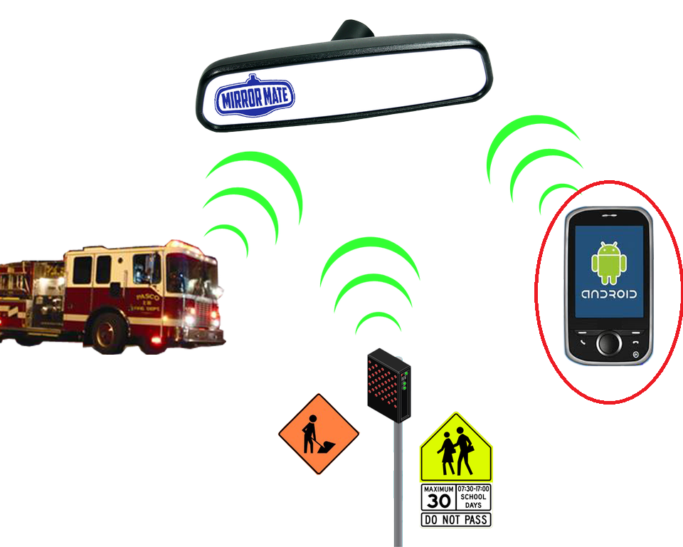
Android Application
Ryan Moreland

Slide 30
Android Development
Application written in Java for Android version 2.3.4 (Gingerbread)
Forward compatible with all newer Android versions
Android holds approximately 75% of the U.S. market share

Slide 31
Android Development
Written utilizing the Google Distance Matrix API
Google Maps JavaScript API
Google Maps Android API
Android Bluetooth API
Notes:
Google’s Distance Matrix API is what is used for the route calculation from one latLong to another. Done externally via a request to googles servers
Request is returned as a JSON (Javascript object) that is then parsed by the app
Maps Android API allows for the surrounding area map to be displayed
Bluetooth API was the reason for the change in development phones from 2.2 to 2.3. MirrorMate uses an “Insecure” connection which just means that you don’t need to enter authentication from both sides. Only authentication from the application is required.

Slide 32
Power
MirrorMate will operate on any standard 12V automotive charging system with provided adapter.
MirrorMate requires 3.3V for all components. This voltage will be created by a simple power supply consisting of a commercially available voltage regulator. (LM1085)
Construction zone beacon requires 5V, it will use multiple LM1084 regulators to power the microcontroller and the large current requirements of the emitters.
Ensures constant voltage for emitters
Notes:
Elaborate on 6V for beacon power

Slide 33
Budget and Financing
$686.46 spent on the MirrorMate system
Assistance from family members
  Funded purchase of LCD ($177.00)
$509.46 funded by group members

Slide 34
Budget
Item | Description | Price
Mirror Hardware Assembly | Hardware and materials used only in mirror assembly | $265.92
Beacon Hardware Assembly | Hardware and materials used only in beacon assembly | $166.87
Electrical Components | Components used throughout the project and for testing | $121.73
PCB’s | Cost of MirrorMate and Beacon PCB | $104.39
Misc. | Misc. costs (RMA shipping, unused parts) | $27.64
Android OS Device | Motorola Photon 4G, Motorola Defy | FREE
TOTAL: |  | $686.46

Slide 35
Testing
2 different types of LEDs were tested to determine optimal beam width to maximize the area of effect of the signal
2 TSOP types were compared to determine which would produce a better signal especially in a IR-noisy environment
Maximum range for the beacon signal to be detected by the mirror in optimal conditions was 950 feet.
Compass headings were verified as correct every 10 degrees
Notes:
One LED type had a longer distance but a smaller beam width (10 degrees) so we combined it with another LED type that had a slightly shorter distance but wider beam pattern (30 degrees).
TSOP we chose was “noise-cancelling” which we verified in both indoor and outdoor environments.
Optimal range was determined to be 950 feet. We tried really hard to get to 1000 but it wasn’t happening. This testing took place at dusk and dark.
Compass default will not show a heading, so if none of the compass values exceed the threshold for a valid signal the compass sometimes will be blank. This was left in as a feature, so as to ensure it should not send an incorrect direction, and often can be solved by verifying the z axis is pointing directly vertical.

Slide 36
Challenges and Lessons Learned
LCD is difficult to see in daylight
IR range is limited in intense daylight
Power supplies need improvement
Notes:
We don’t actually have an opticom so we fudged it with the beacon
We don’t ever work on our project
We faked 1441 pages last semester
We arent very good at typing on the fly
Ryan is the only one typing
Matt loves drawing pictures
Jake loves shiny things
Jerome is a cool guy
IR RANGE WE CAN TALK ABOUT THIS FOREVERERERR
Interfacing Android API with Bluetooth hardware
Interfacing LCD with everything

Slide 37

Questions

